Slide 1
Team Land Final Report
May 16 (Fri 2025)
Do Ngoc Khanh, Ching-Hung Shih, Kei Yoshimura, Shuping Li, Ryotaro Omae, Chu-Yi Chang, Jie Hsu, Ren-Jie Wu, Yen-Ting Chou

Slide 2
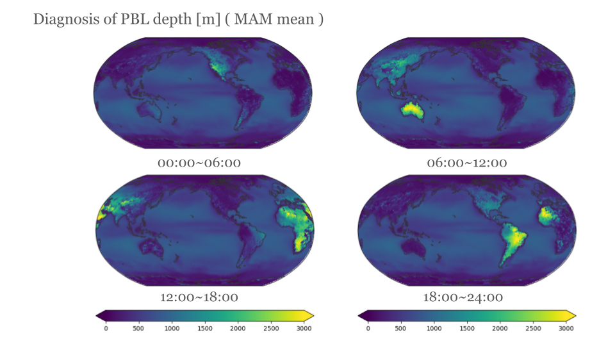
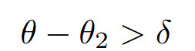
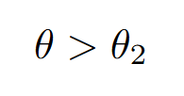
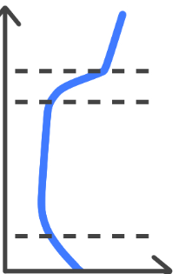
Diagnostic PBL Depth (Ryotaro Omae)
Method
PBL Height = the first layer of : Potential temperature of 2nd layer from the ground δ : 1.25(Land), 0.75(ocean)
mean
→ δ

Slide 3
Brief Summary
Dry Process
Relationship between sensible heat flux and temperature
Hot event in Tokyo
Diagnostic PBLH depth
Moist Process
Soil Moisture-Precipitation relationship
Land coupling index
Soil Moisture-Evaporatev Fraction regime
Mechanism behind negative correlation between SM-P
Extreme precipitation induced by strong land coupling

Slide 4
Things we learned
How to handle a huge dataset properly.
Efficient usage and correct interpretation of healpix data structure.
Changing from coarse to fine spatial resolution in model causes overall difference in modeling results, as it more explicitly represent the land-atmosphere processes such as convection.

Slide 5
Challenges we faced
Unfamiliar data format, size, and spatial coverage at first.
Reversed signs in sensible and latent heat flux at zoom level 9
Soil moisture variable missing in the Healpix dataset
Coarse vertical coordinate above high elevation area

Slide 6
Expectation in future events
Provide coarser resolution of NICAM simulation for comparison

Slide 8
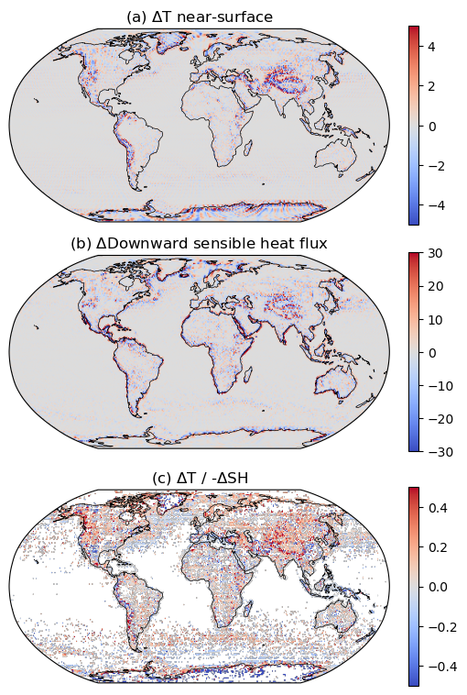
Thermal Process
Presented question: What information is gained, or loss, when zooming in/out.
March monthly mean result, zoom 5 vs 7 ⇒
Little change on the ocean.
On land, large ΔT and ΔSH around mountainous area (Andes, Himalayas, Rockies).
-ΔT/ΔSH > 0, in general.

Slide 9
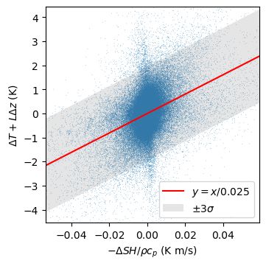
A statistical model (March)
ΔT = -L Δz - ΔSH / (a ρc_{p})
Δz (m): Height difference between two zoom levels,
ΔSH (W/m²): Sensible heat flux difference,
ρc_{p} (J/m³ K): Volumetric heat capacity of air.
Fitted parameters
L (K/km): temperature lapse rate. → L = 6.6 K/km. (Adiabatic lapse rate 9.8 K/km)
a (m/s): some empirical parameter. → a = 0.025 m/s. Why?

Slide 10
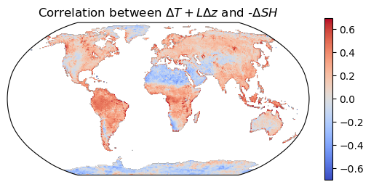
One-year correlation analysis
Usual expectation: More SH ⇔ higher temperature.
In dry region (e.g. Sahara), the reverse seems to be true.
I don’t know why, but some land experts may know.
My teammates also found similar patterns in other context.

Slide 11
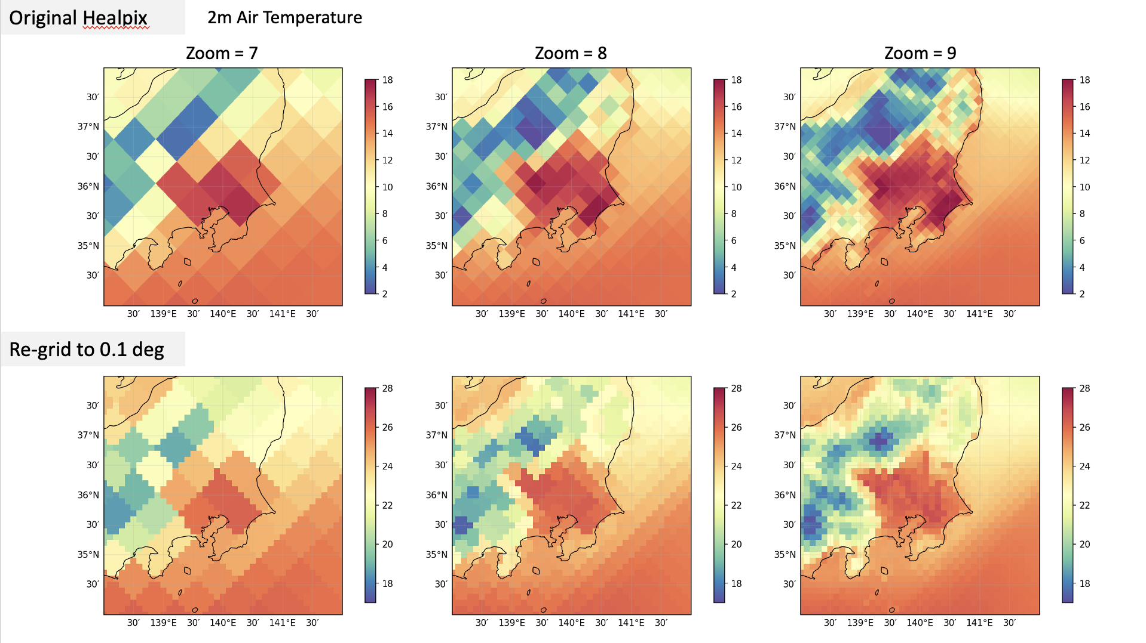

Slide 12
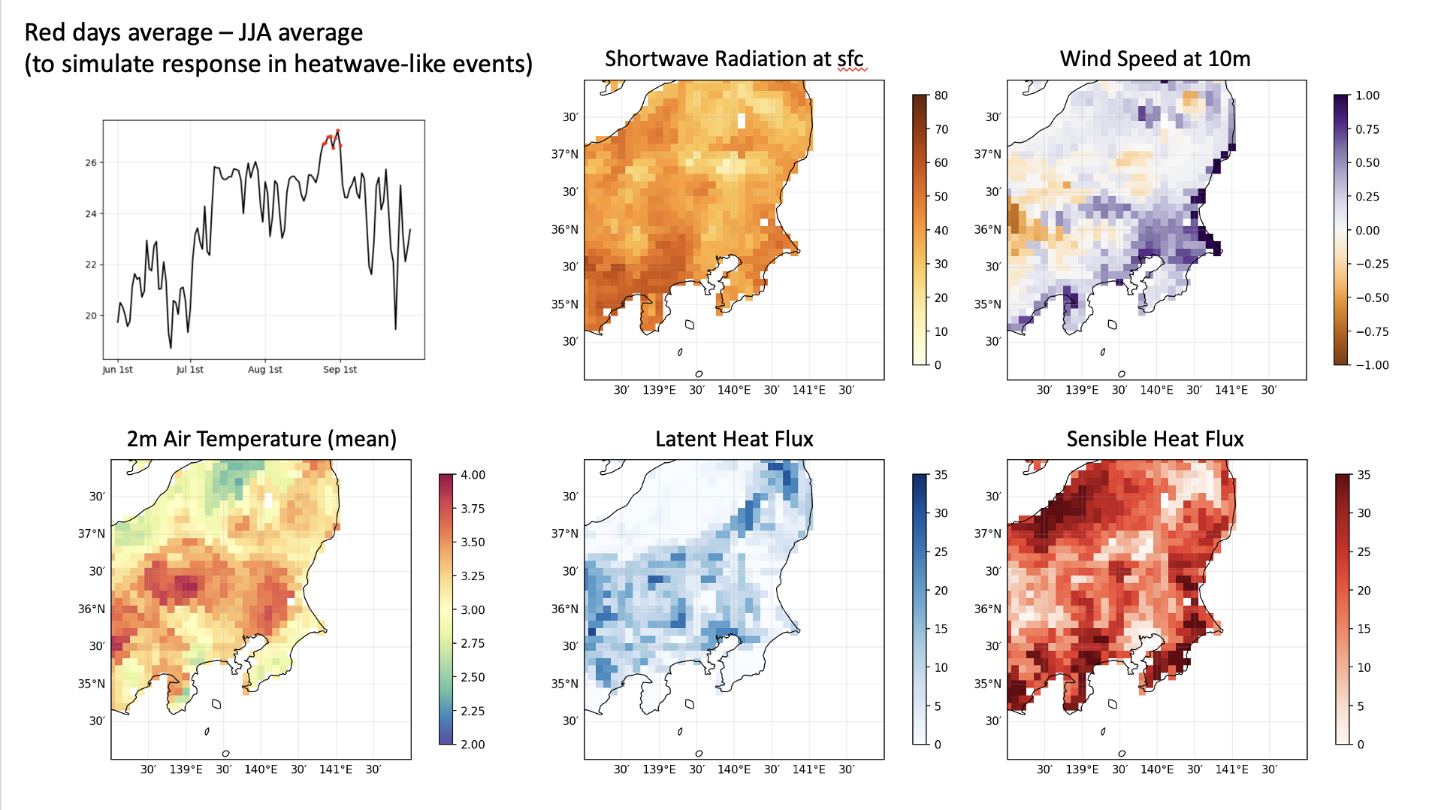

Slide 13
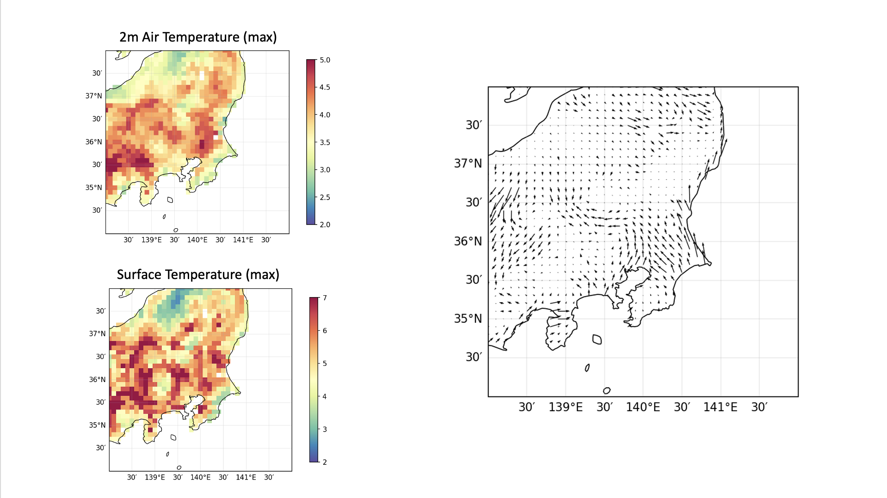

Slide 14
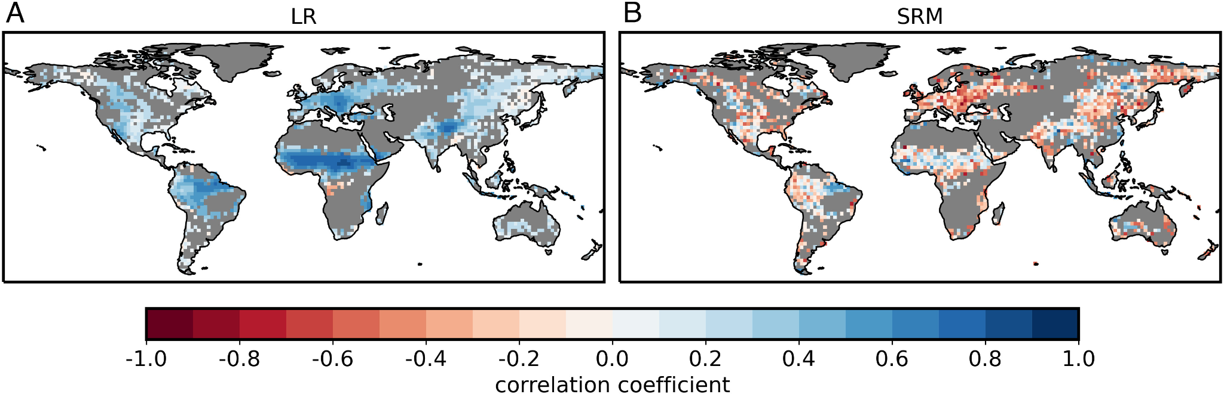
SM-P correlation (ICON, results from Lee et al., 2024)
160km
5km
Model | Resolution | Convection setting | Correlation sign | Correlation significance
LR | 160km | parameterization | postive | strong
SRM | 5km | explicitly solved | nagative | intermediate

Slide 15
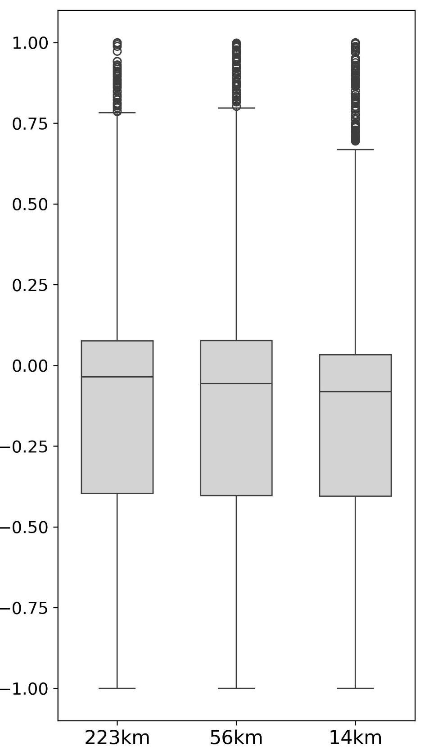
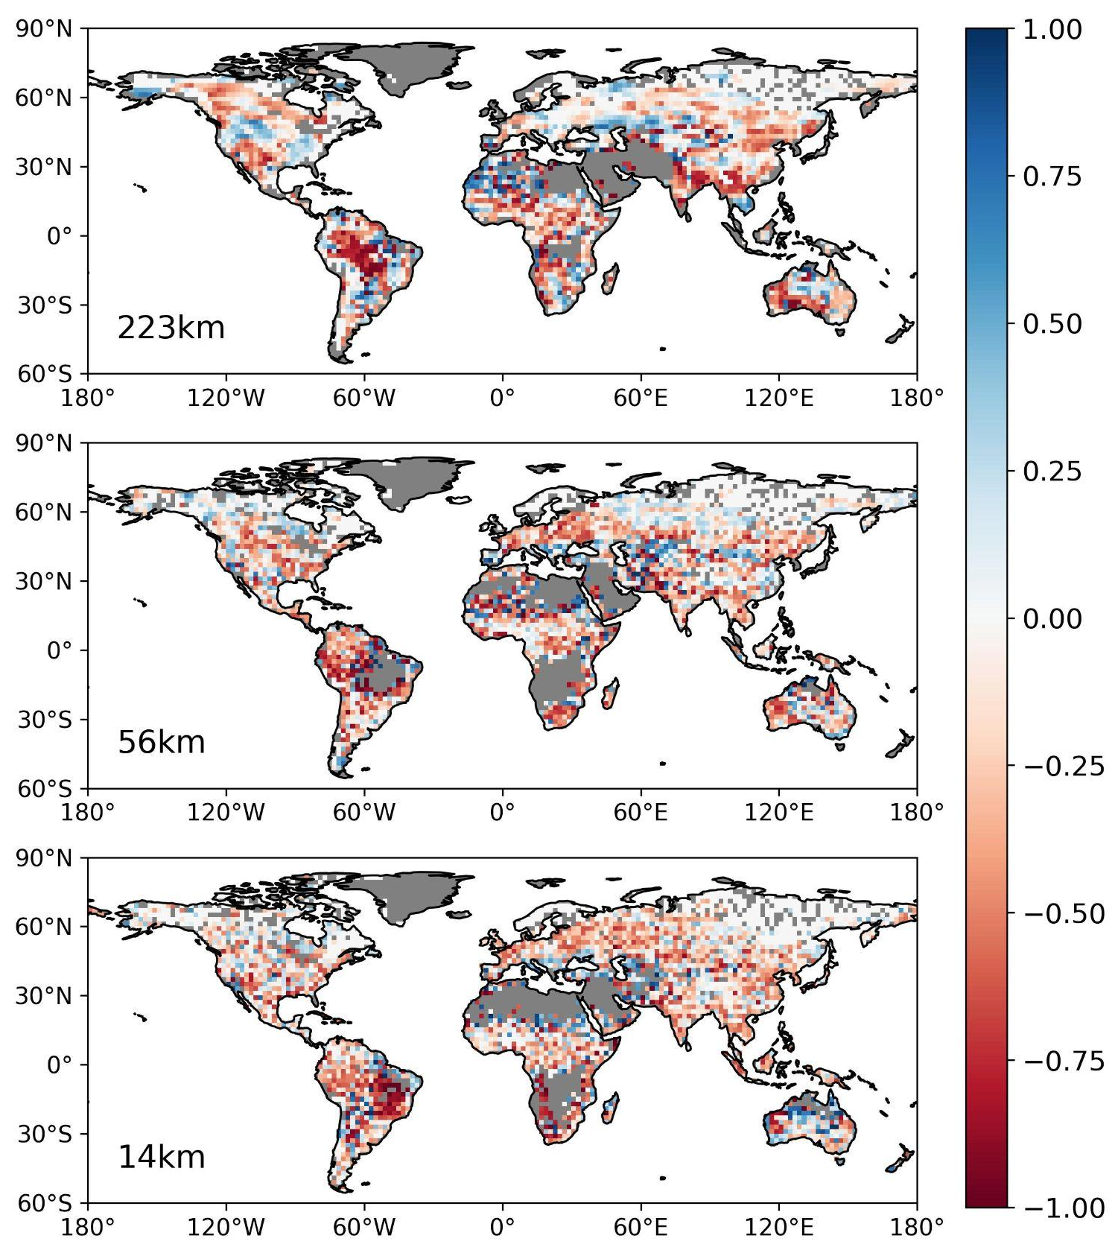
SM-P correlation (NICAM, product by Tanoue et al., 2023)
1.Not as homogeneously positive as ICON for coarse resolution (223km)
2.From coarse to finer resolution:
spatial pattern becomes more heterogeneous
negative correlation shown in more area
* convection is explicitly resoved for all resolutions in NICAM

Slide 16
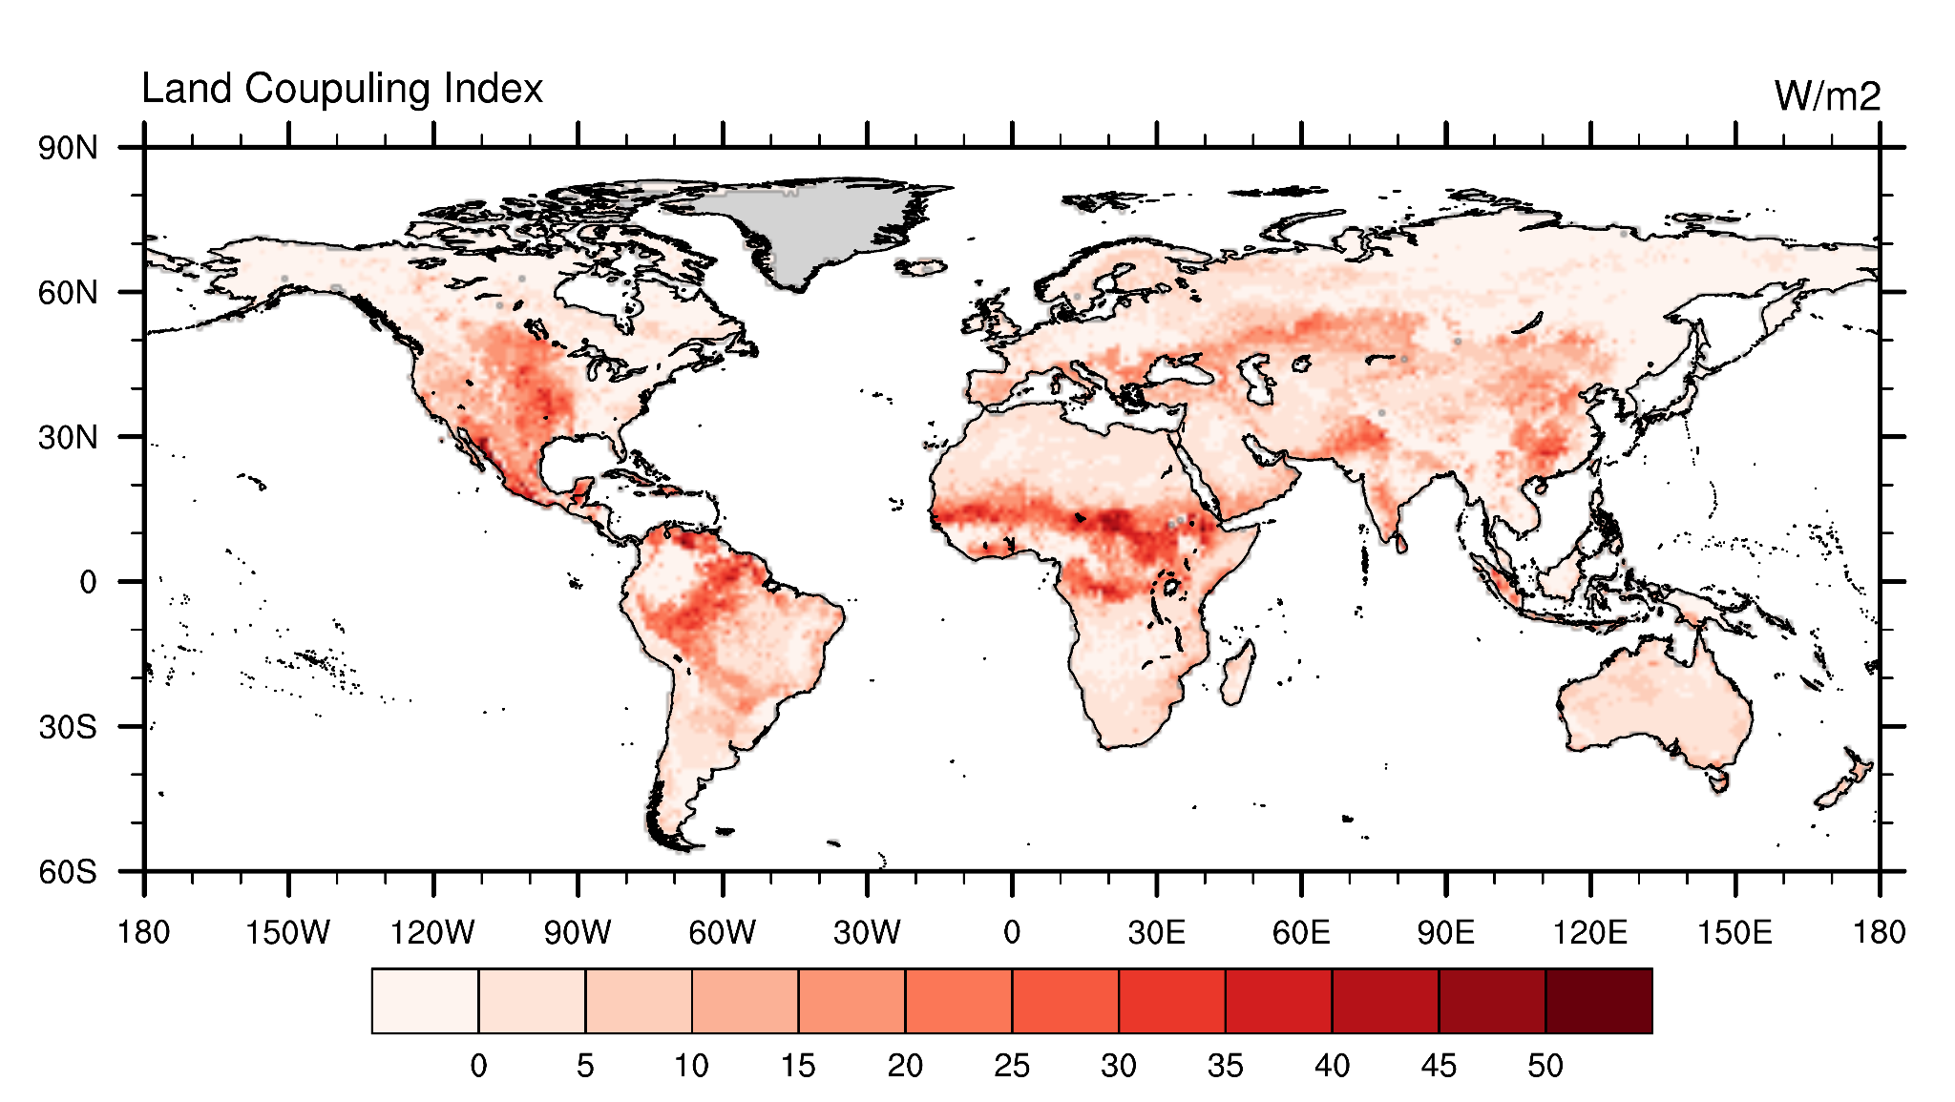
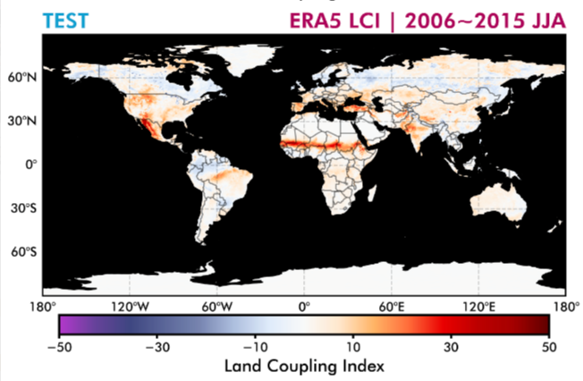
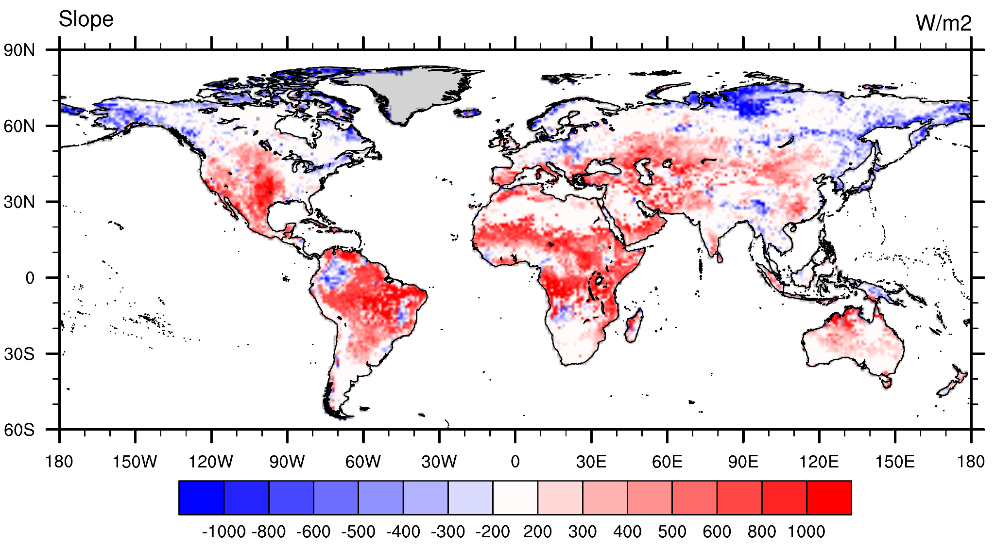
Land Coupling Index
Land Coupling Index = Reg(SM, ET) * std(SM)
Strong land coupling in Mid-US, Mid-Africa, and Amazon (hot spots)
May have strong SM-LH-P feedback
Interesting findings
negative SM-P: Northern SA
positive SM-P: Mid-US and Mid-Africa

Slide 17
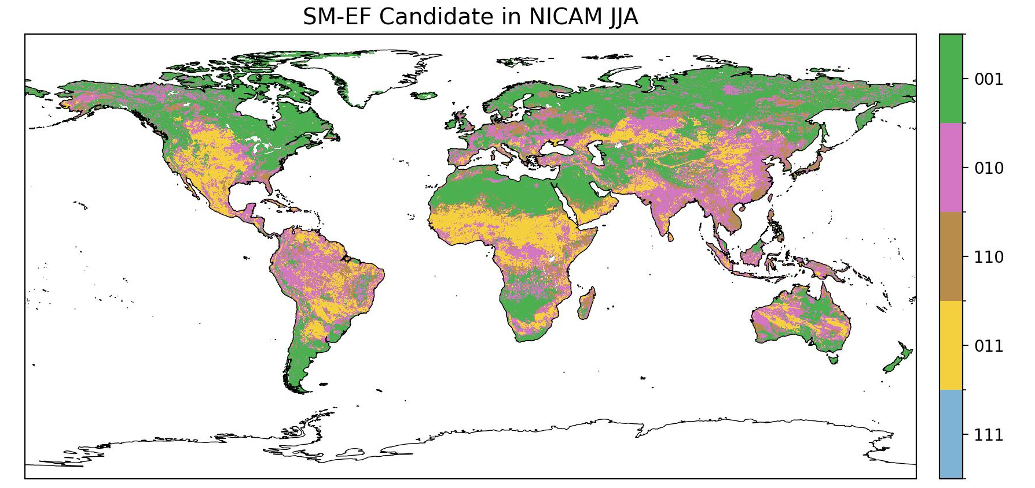
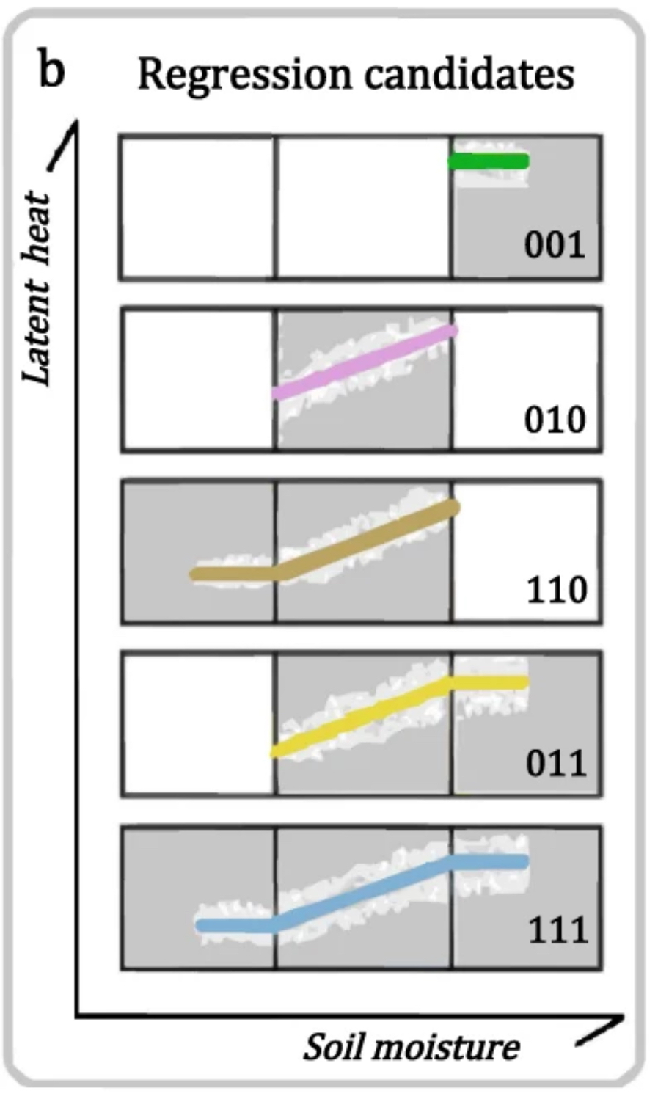
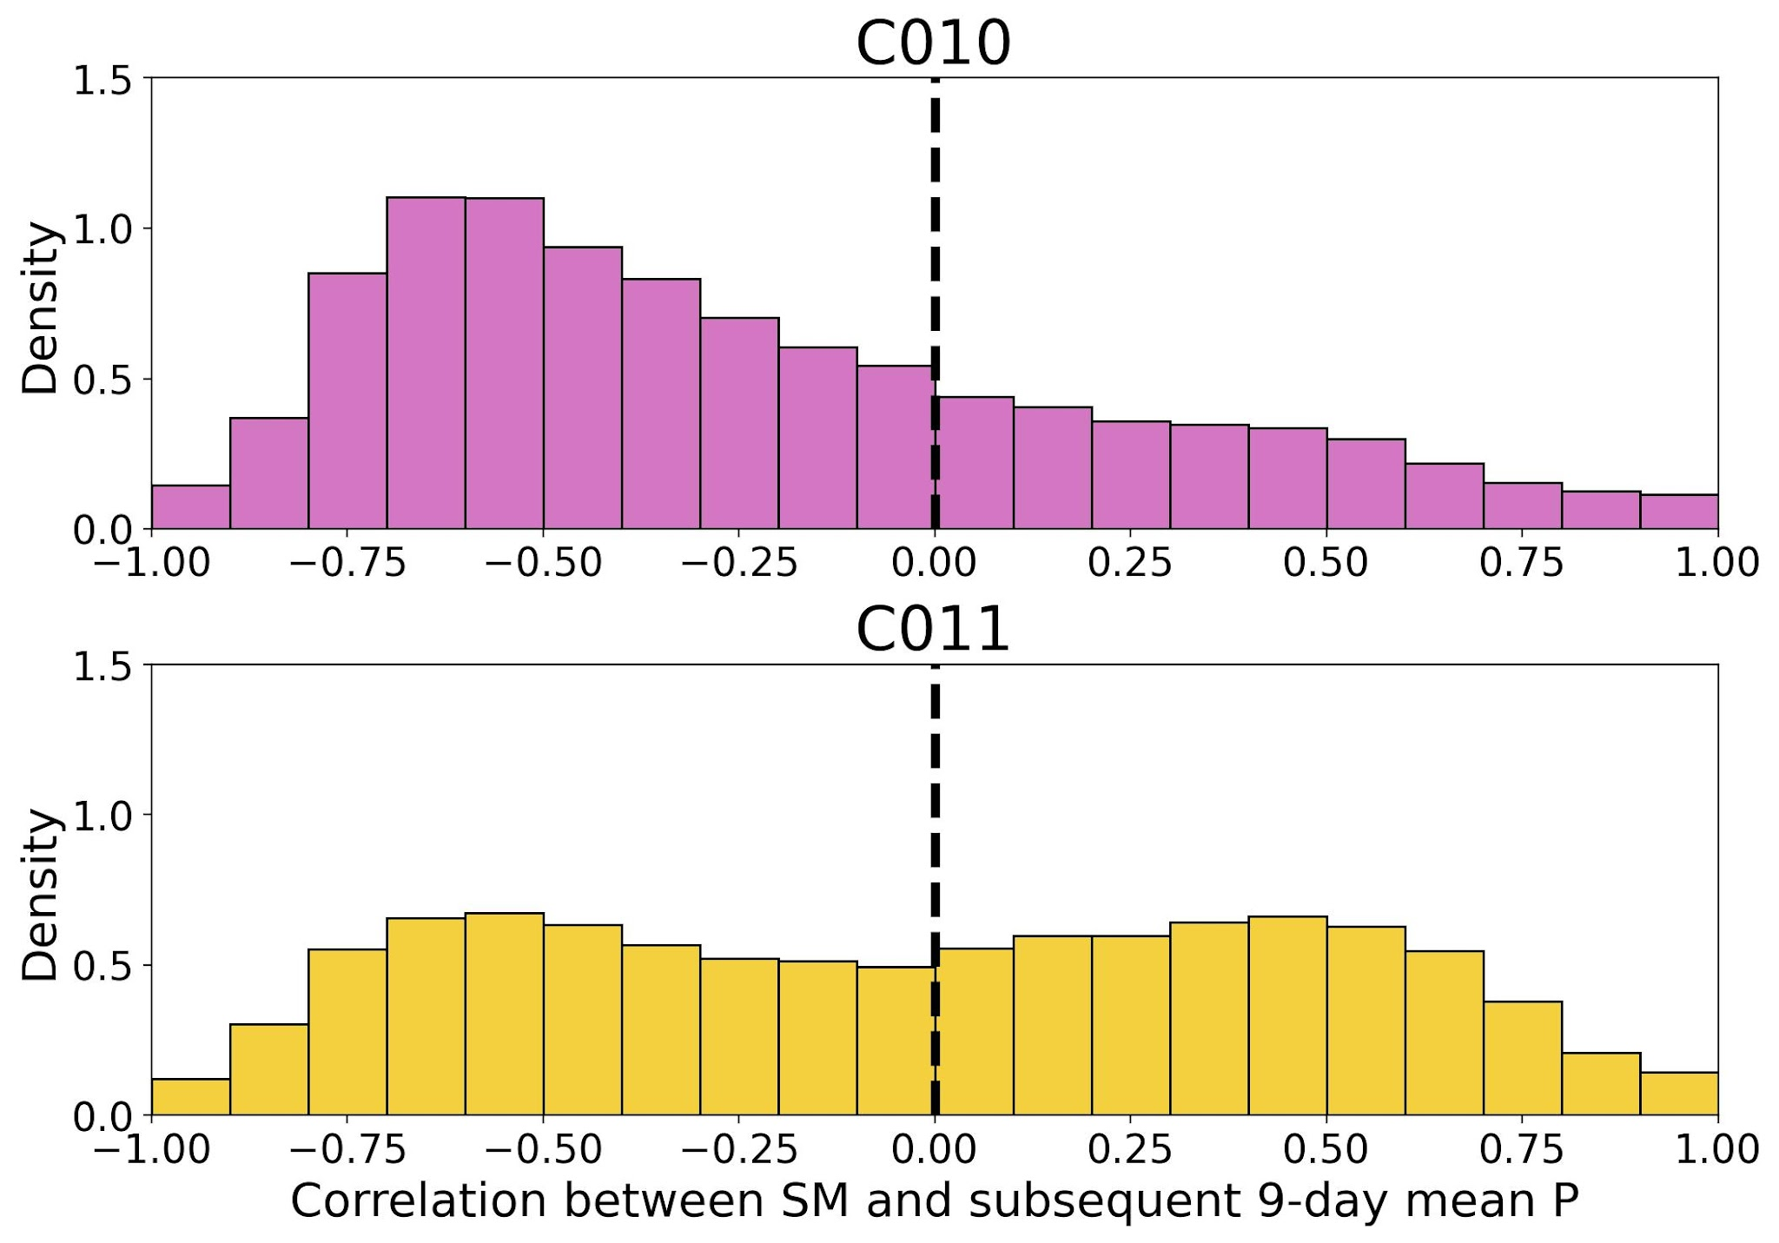
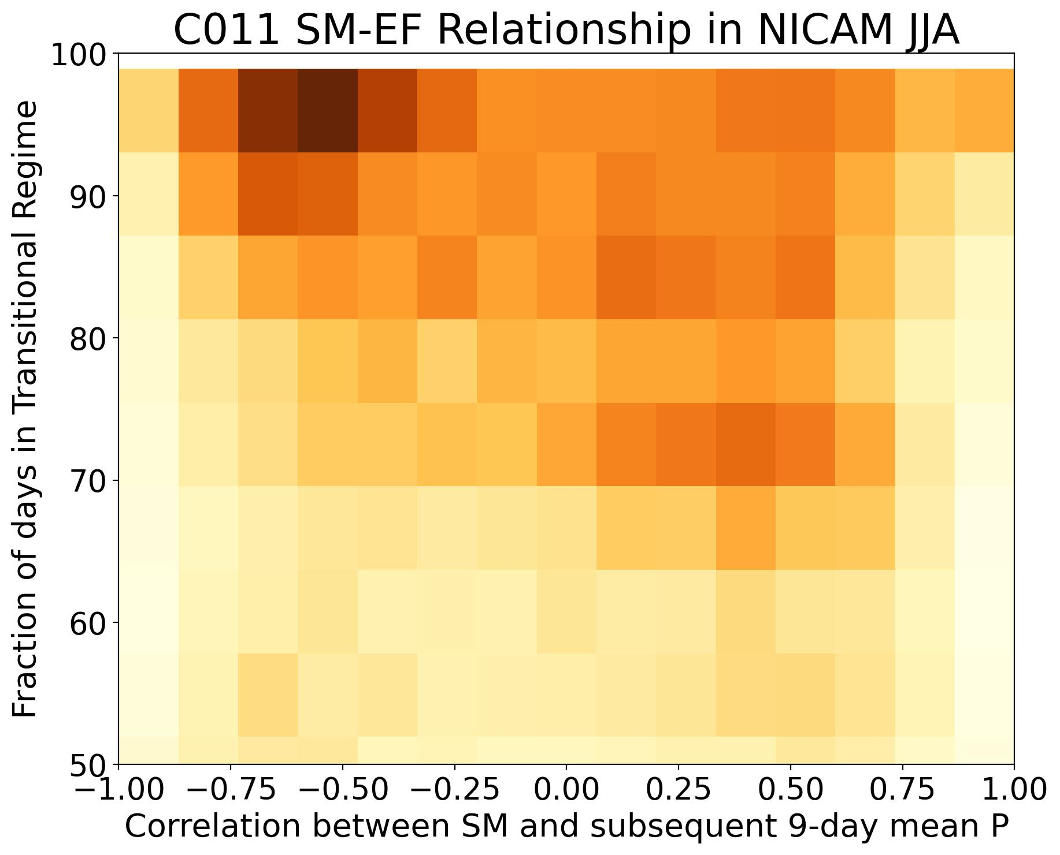
SM–EF Relationship in NICAM JJA
In regions with strong LCI:
C010: negative soil moisture–precipitation (SM–P) feedback
C011: negative SM–P feedback, when more days are within the transitional regime
transitional regime

Slide 18
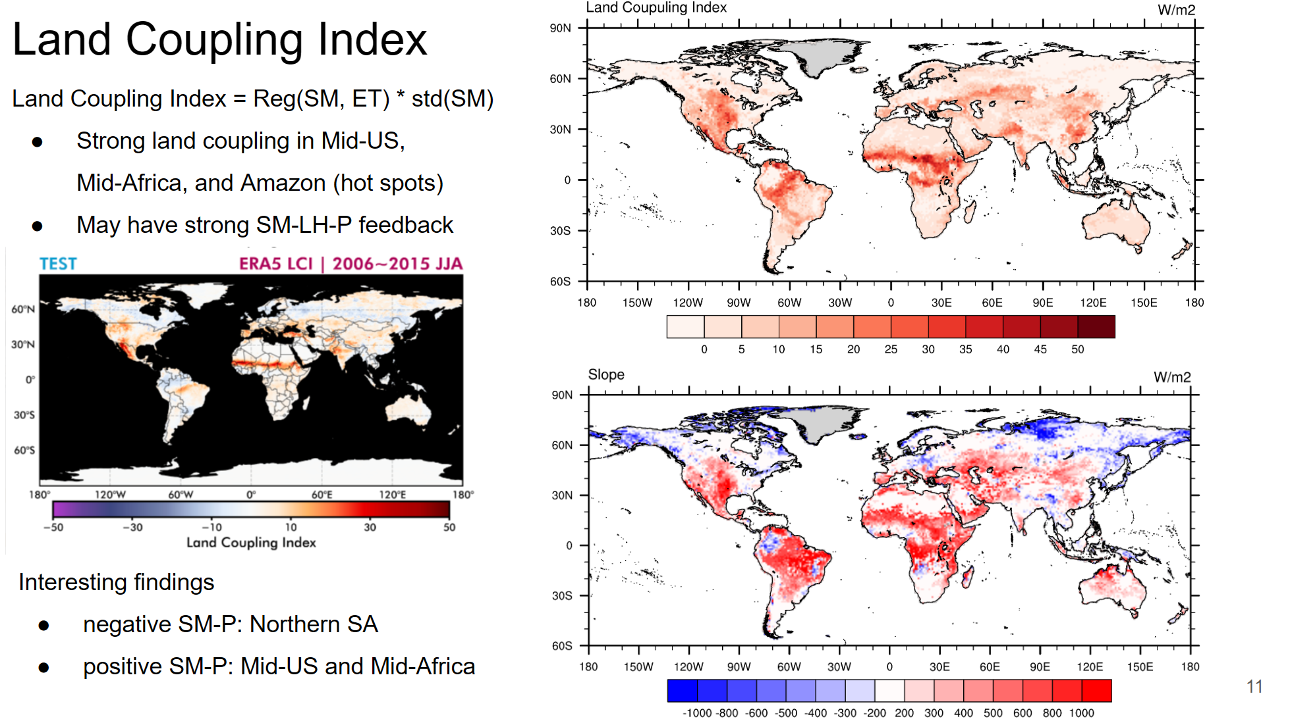
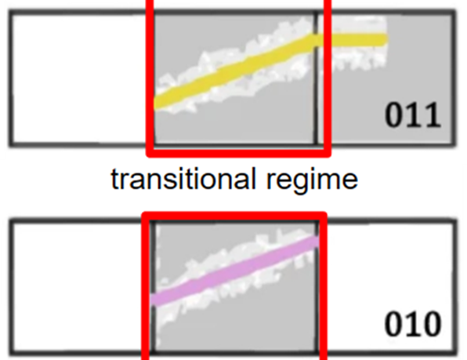
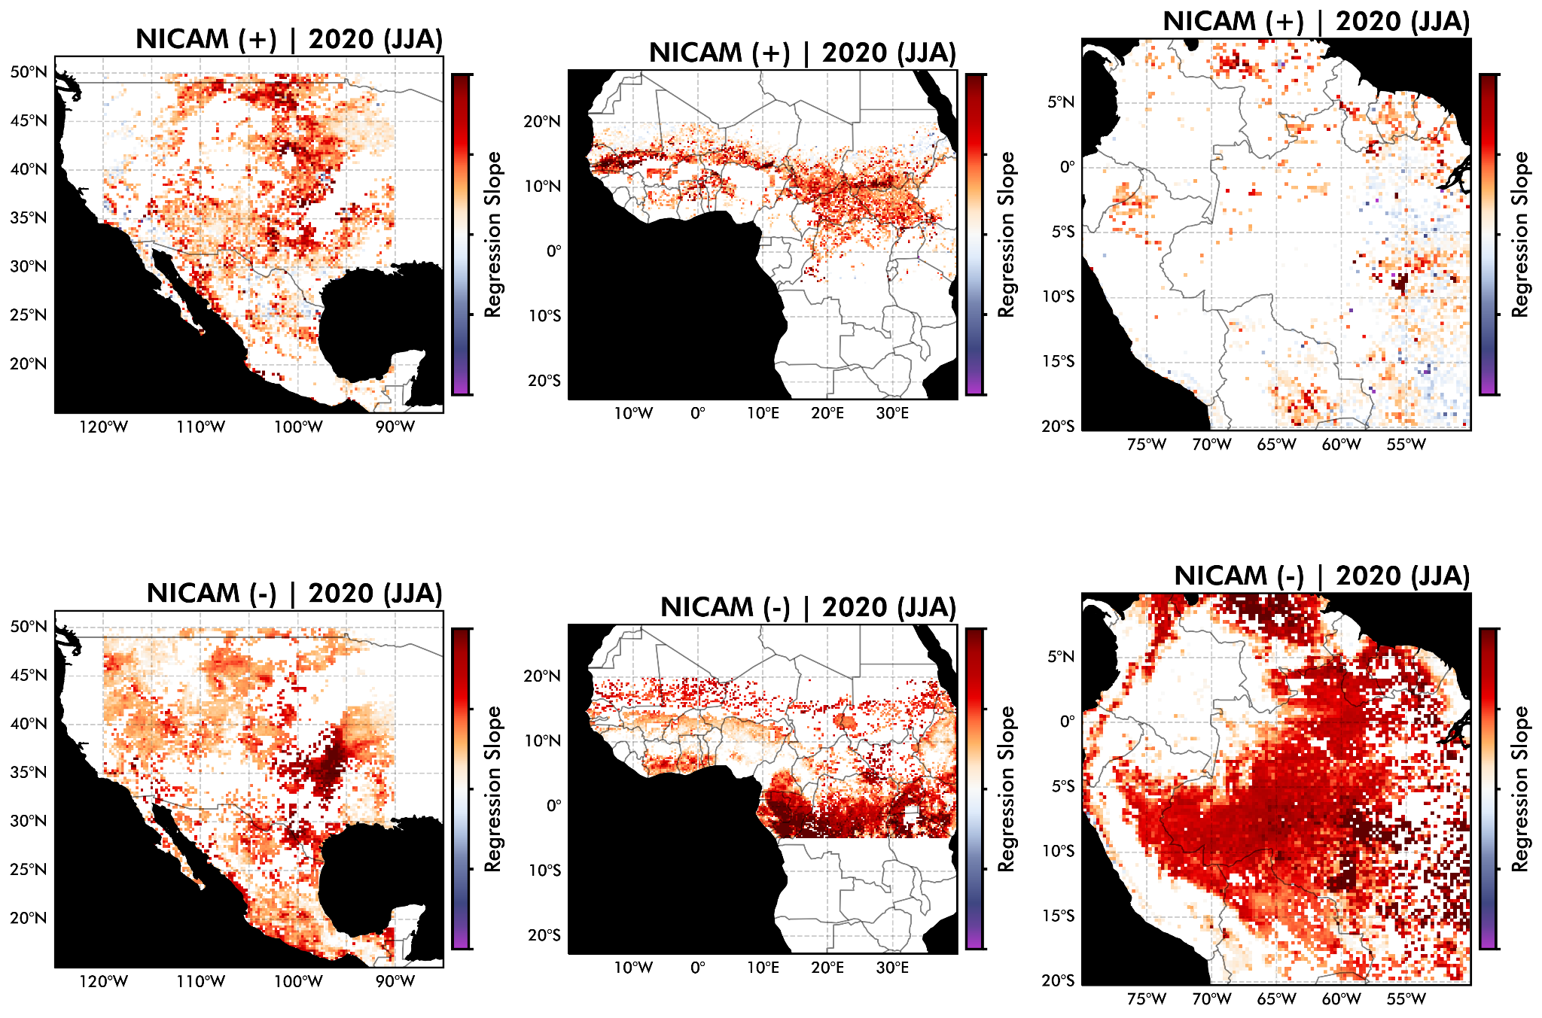
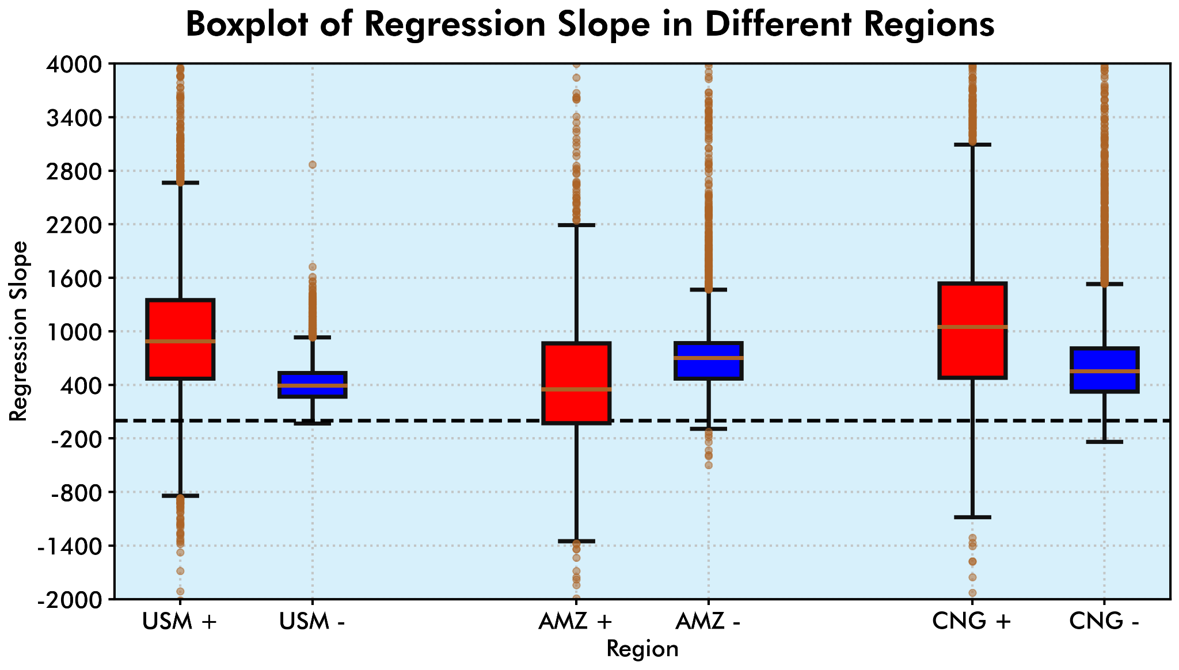
SM-ET in Transitional Regime
What happens (SM-ET slope) in the transitional regime between
Positive / Negative SM-P feedback.
Positive: C011
First Segment Slope of Piecewise Correlation
Negative: C010 (more day in transitional regime)
Slope of Linear Regression
Postive SM-P feedback
Negative SM-P feedback
Similar SM-ET but Different SM-P? (WHY?)
Notes:
We are curious about what happens “the SM-ET slope exactly be” in the transitional regime

Slide 19
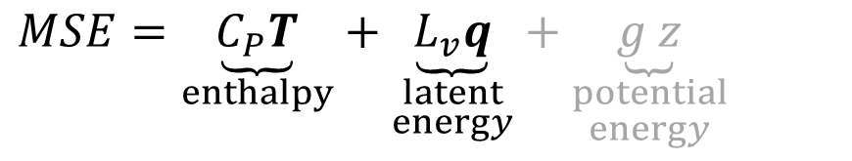
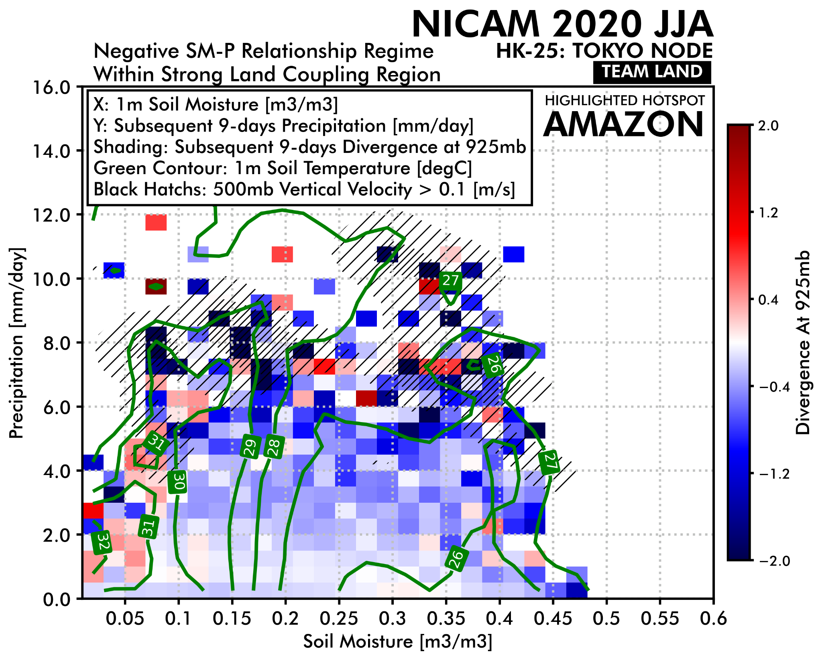
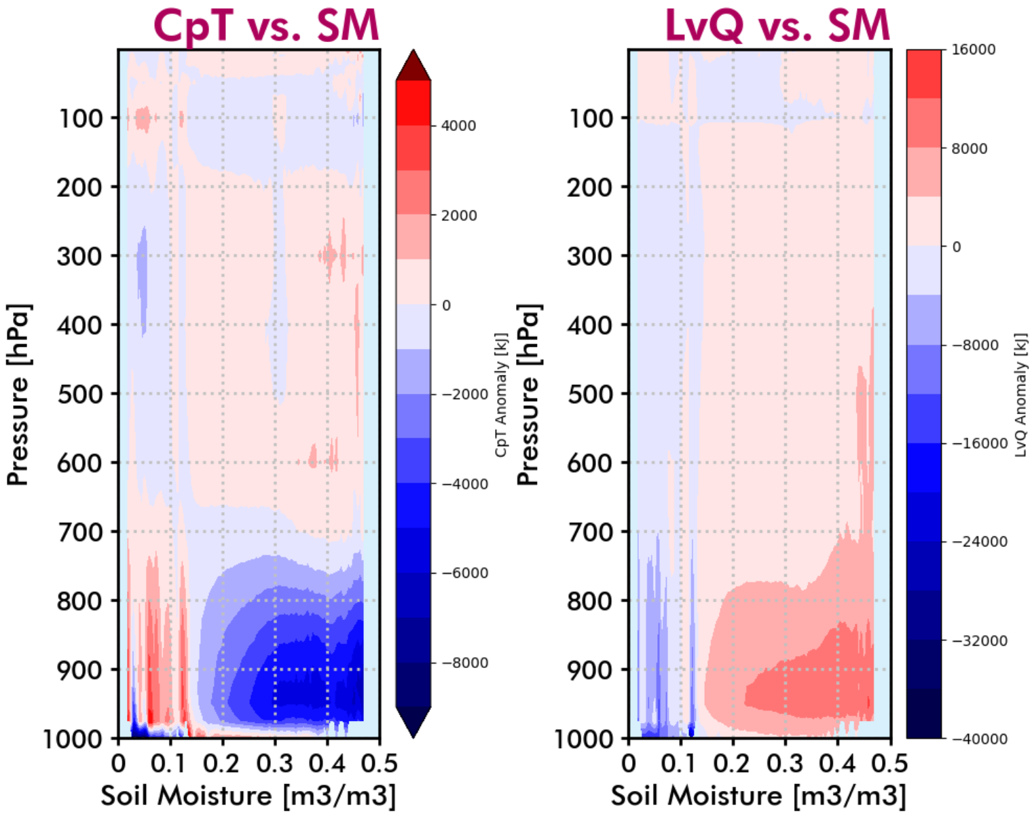
Negative SM-P Feedback
Strong land coupling region and negative SM-P feedback: Amazon.
SM slightly dry region with higher soil temperature prefers to having convergence and precipitation.
Warmer ground over the dry SM region tends to increase low-level enthalpy and moist static energy.

Slide 20
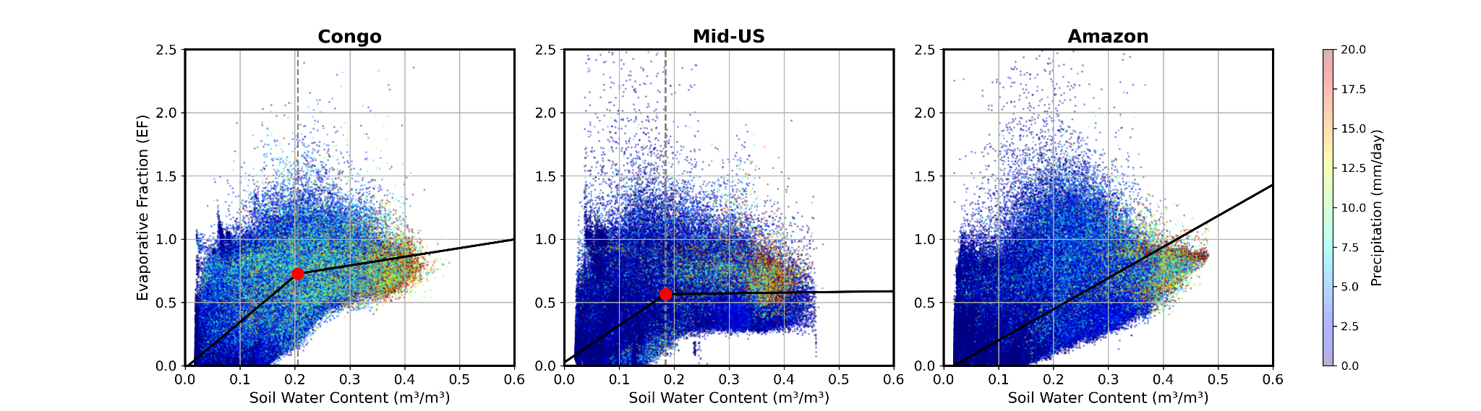
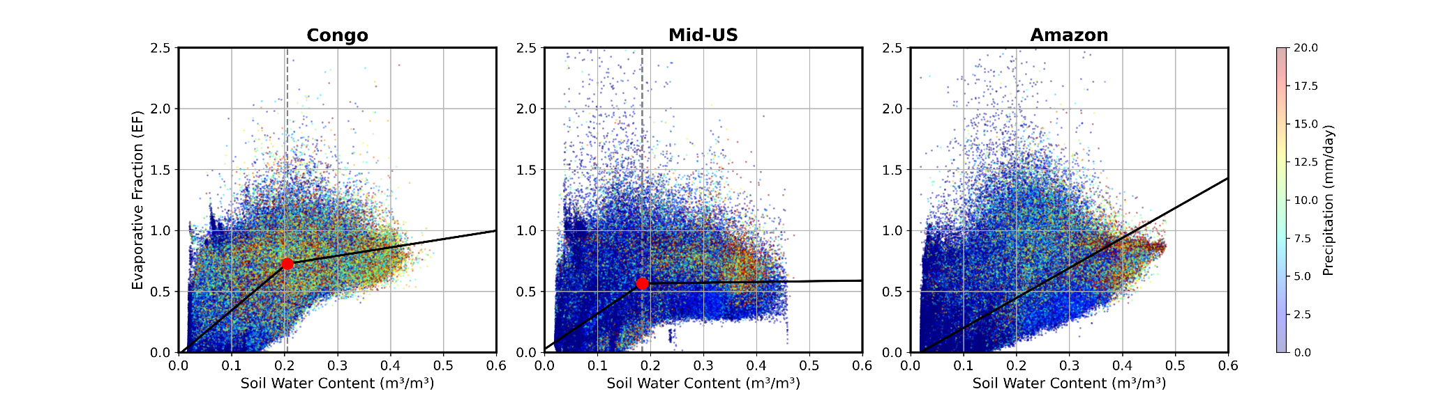
Strong coupling induced extreme precipitation
Subsequent 9-day mean Precip.
Subsequent 9-day Precip. variability (STD)
Extreme precipitation could occur under wet soil moisture conditions.
The Congo exhibits strong variability in the subsequent 9 days, indicating that extreme events may occur under both water- and energy-limited conditions.

